Slide 1

Aeolian Systems: Processes and Deposits
Ian Kane & Grace Cosgrove

Slide 2
Aeolian Systems: Processes and Deposits
What are aeolian transport processes and where do they operate?
How do aeolian bedforms develop?
How do migrating bedforms in active dune fields form sediment accumulations?

Slide 3
Aeolian Systems: Processes and Deposits
What are aeolian transport processes and where do they operate?
How do aeolian bedforms develop?
How do migrating bedforms in active dune fields form sediment accumulations?

Slide 4

What are aeolian environments?
The adjective, aeolian describes genetic processes and products of, erosion, entrainment, transportation and deposition by the wind.
The term derives from the Latin Æolus, god of the winds (itself borrowed from Greek Αἴολος, lord of the winds).
Notes:
By Ed Stevenhagen (Overleg) . - from nl.wikipedia Afbeelding:Aeolus1.jpg, Public Domain, https://commons.wikimedia.org/w/index.php?curid=764432

Slide 5
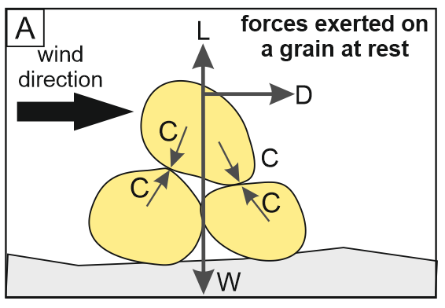
Aeolian transport processes
Aeolian sediment entrainment occurs when and where wind forces are able to overcome the effects of surface stabilisation.
For grains of sand and finer grade, ballistic impacts and aerodynamic lift promote entrainment, whereas particle weight, friction, drag, and cohesive inter-particle forces retard entrainment.
Drag and lift are generated by fluid flow over and around particles, whereas weight, friction and cohesion are determined by particle size, density, shape, packing, moisture content, mineralogy and degree of inter-particle cementation (Lancaster, 1995).
L = lift, C = cohesion, D = aerodynamic drag, W = weight, I = impact.
Image: Mountney et al., 2023

Slide 6
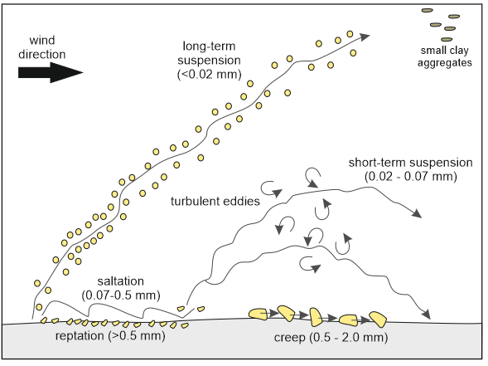
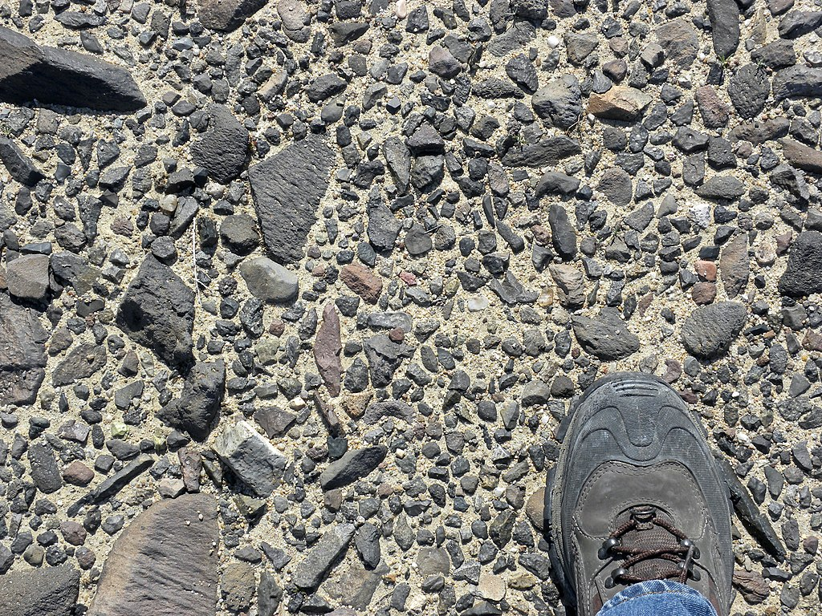
Aeolian transport processes
The construction of dunes and sandsheets requires the availability of abundant sand grains, which are mostly transported as bedload prior to deposition.
By contrast, silt and clay fractions are mostly transported aloft in suspension.
Under most wind conditions, gravel and coarser sediments are not moved, and are left in situ as a deflation lag deposit: a reg or serir.
Above: Schematic representation of the main modes of aeolian sediment transport with typical grain sizes indicated. Modified after Pye (1987). Left: Reg in Mojave Desert, Southern California (Image courtesy of Wilson44691)

Slide 7
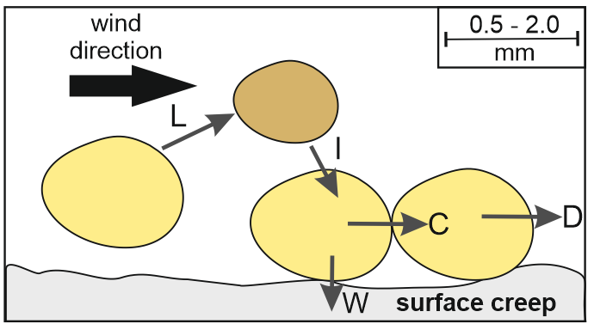
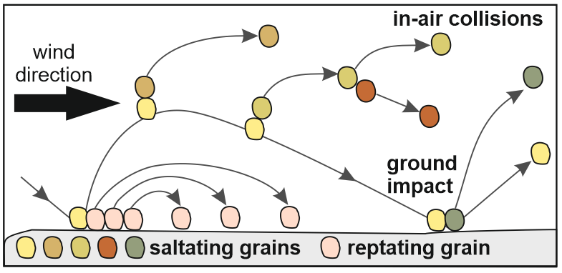
Aeolian transport processes
L = lift, C = cohesion, D = aerodynamic drag, W = weight, I = impact.
Sand carried as bedload may be transported by one or more of the following processes:
(1) rolling or creep due to drag directly on the bed
(2) saltation whereby particles are temporarily lifted into the airflow and then collide with other particles in the flow, thereby inducing a chain reaction of interparticle collisions
(3) reptation whereby saltating particles that return to the bed impact and nudge other particles and cause them to hop short distances downwind.

Slide 8
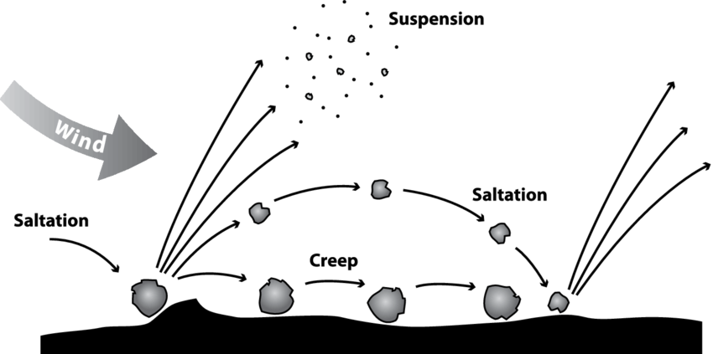
Aeolian transport processes
Of these processes, saltation is especially important in the aeolian transport of sand; wind impact ripples (discussed later) owe their distinctive form to this process.
Tatarko, John & Presley, Deann. (2009). Principles of Wind Erosion and its Control. K-State Research and Extension Publication. MF-2860.

Slide 9
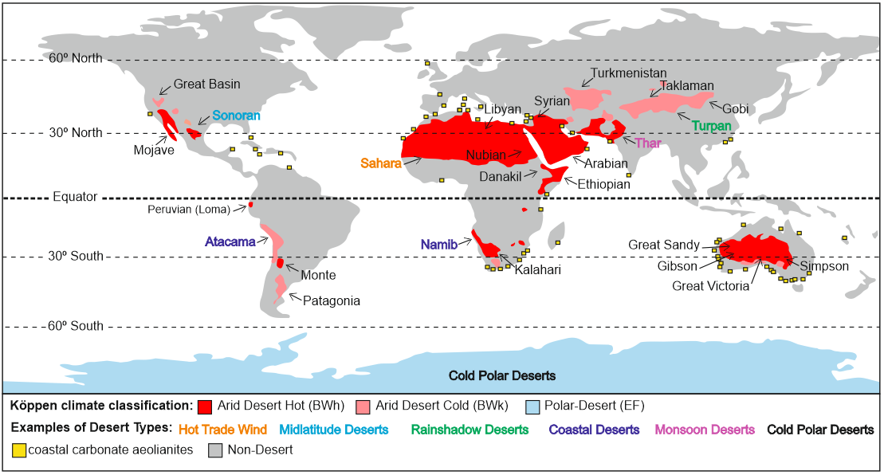
Where do aeolian processes operate?
Aeolian processes operate in a variety settings:
Hot and cold climatic deserts, coastal region, fluvial and glacial outwash plains, volcanic regions and aeolian systems supply sediment to the deep ocean.
Although aeolian processes operate in various climate regimes, they are currently most active and widespread in arid, hot and cold deserts.
In these settings, dry sandy substrates that lack significant vegetation cover are prone to sediment erosion, transport and deposition via the wind.
Image: Mountney et al., 2023

Slide 10
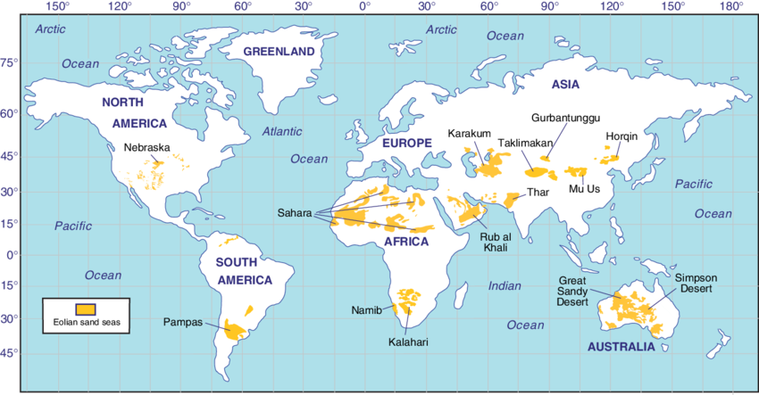

Desert aeolian environments
Aeolian processes and resultant deposits are most widespread in the world’s climatic desert regions.
Approximately 30% of the present-day land surface is characterised by arid or semi-arid climatic conditions
Of this 30%, aeolian sand deposits cover 20% of these regions (6% of the Earth surface).
In these arid and semi-arid regions, low amounts of precipitation result in a dry substrate with relatively sparse vegetation cover. This allows the wind to entrain and transport loose surface sediment.
Modern distribution of aeolian sand (Muhs, 2009)
Rub’ Al Kali Desert (mage from www.wildfrontierstravel.com)

Slide 11
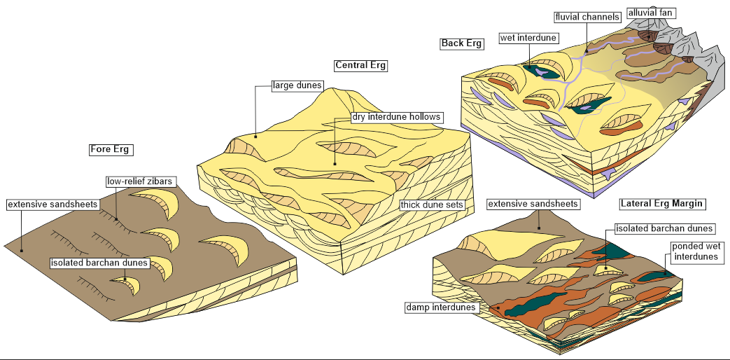
Desert Environments
Dunefields can be divided into central and marginal regions; these regions have distinct characteristics that differentiate them from each other.
The back-erg represents the trailing, upwind margin of the erg; the fore-erg represents the leading, downwind margin of the dune-field (Porter, 1987). The central erg is located in the core of the dune-field between the leading edge (fore erg) and trailing edge (back erg) of the dune system. Collectively, the fore- and back-erg, and the lateral margins of the central erg make up the erg margin, which surrounds the central erg at the core of the dunefield

Slide 12
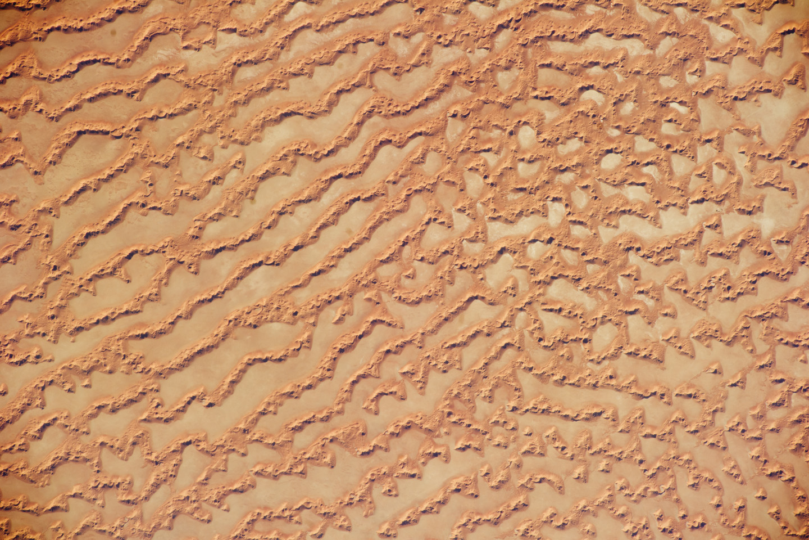
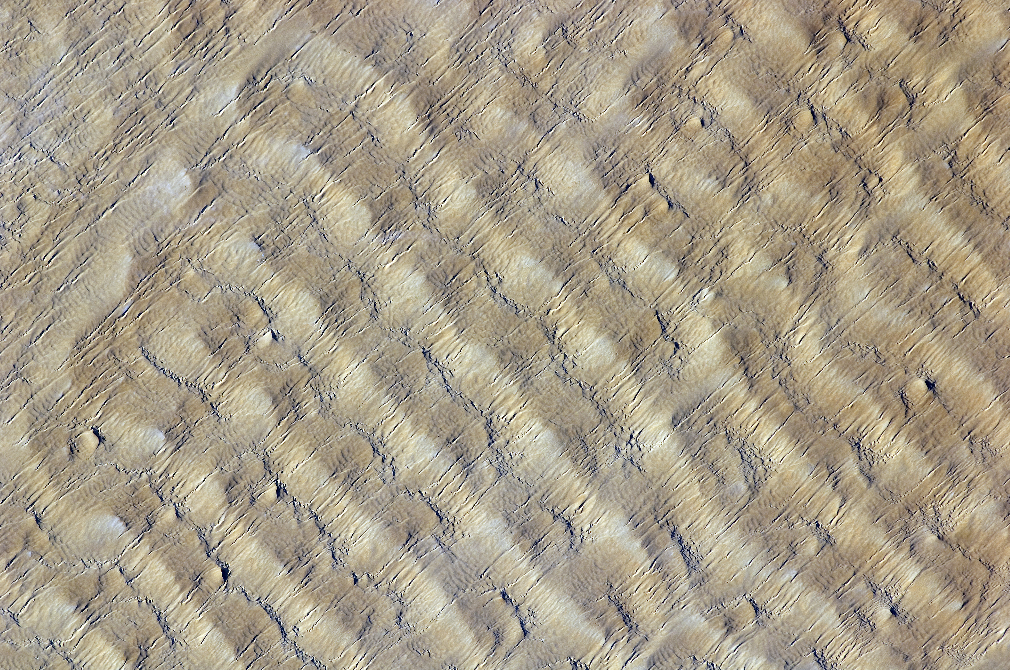
Desert aeolian environments
Rub’ al Khali, Oman
(Image ISS027-E-34290)
Most larger deserts are subdivided into a series of distinct geomorphic elements, defined by net sediment erosion, transport (bypass), or deposition.
Geomorphic elements characterised by net aeolian sand deposition may develop as sand seas or ergs.
Ergs are wind-formed desert landscapes characterized by extensive sand dunes that cover the terrain.
Sand dunes can also be associated with other geomorphic elements, such as zibars, sandsheets, interdunes and a suite of non-aeolian environments (such as rivers, playa lakes etc.).
These geomorphic elements will be discussed later on.
dune
interdune
10 km
Tenéré Desert, larger Sahara Desert, Niger
(Image ISS022-E-5258)
sandsheet
zibar
5 km

Slide 13
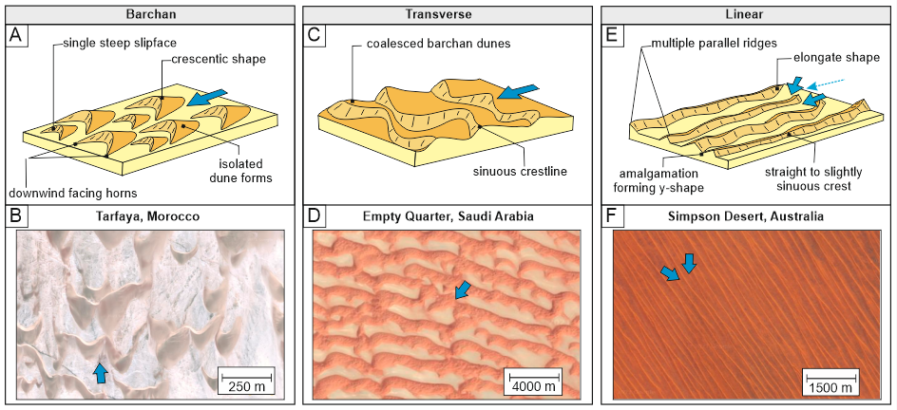
Dune Types
Image: Mountney et al., 2023

Slide 14
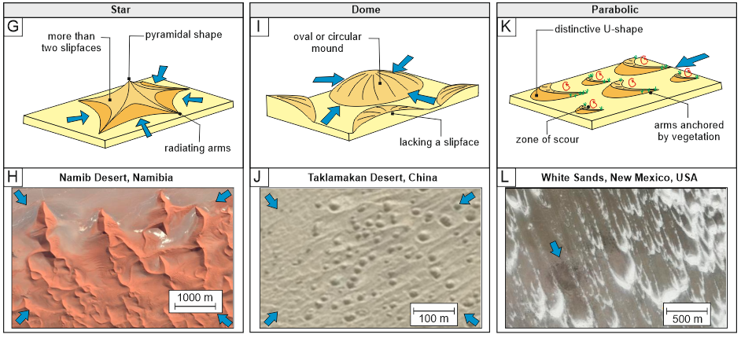
Dune Types
Image: Mountney et al., 2023

Slide 15
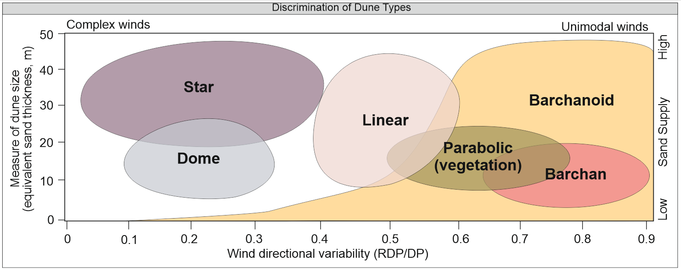
Dune Types
Discrimination of dune types in relation to a plot of Equivalent Sand Thickness (EST) versus Resultant Drift Potential (RDP)/Drift Potential (DP). Modified after Wasson & Hyde (1983).

Slide 16
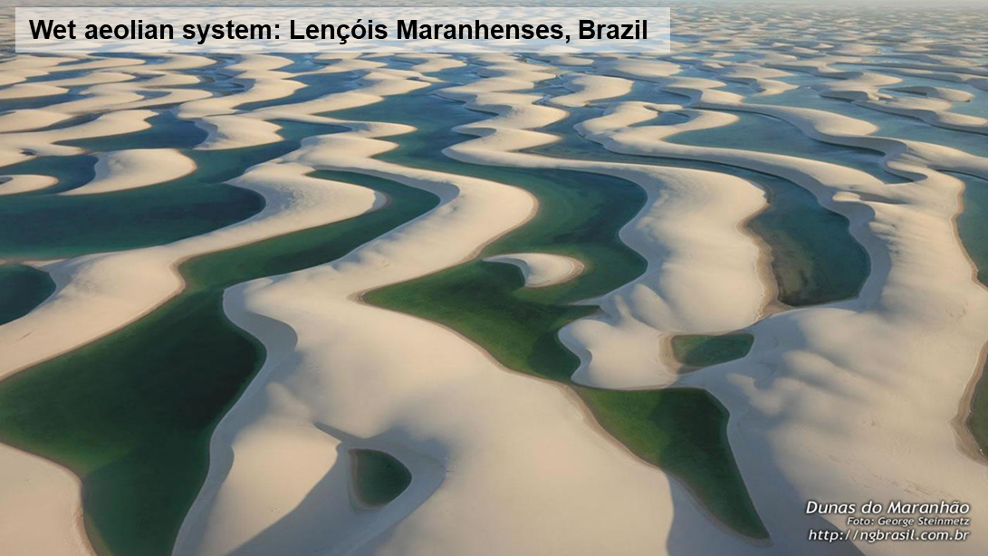
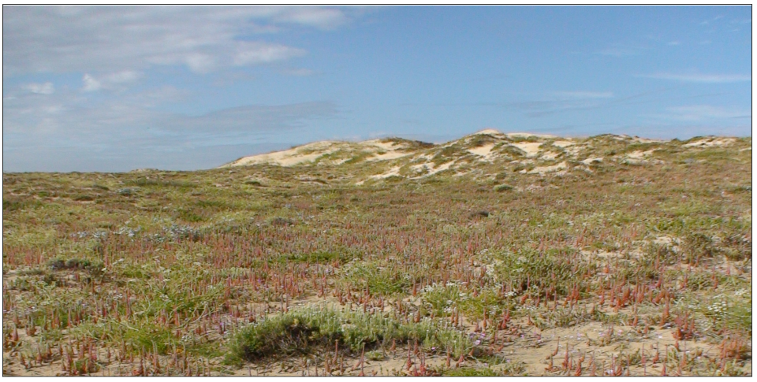
Desert aeolian environments
Tenéré Desert, larger Sahara Desert, Niger
Both present-day aeolian systems and their preserved successions are commonly classified as dry, wet or stabilising types (Kocurek & Havholm, 1993).
Dry aeolian systems develop where accumulation is controlled solely by aerodynamic configuration. Down-wind airflow deceleration causes sediment-laden winds to deposit some of their load.
Wet aeolian systems develop where accumulation is controlled by progressive water-table rise concomitant with ongoing aeolian activity – notably, dune migration.
Stabilising aeolian systems develop where physical, chemical or biogenic agents promote aeolian system construction and accumulation. For example, where vegetation or surface cements act to restrict the transport capacity of the wind.
(Image ISS022-E-5258)
Stabilising aeolian system: Baleal, Peniche, Portugal
Image courtesy of Júlio Reis (CC BY-SA 3.0)

Slide 17

Coastal aeolian environments
The Namib Desert borders the South Atlantic Ocean. It stretches along the western coast of Namibia, which is a country located in southwestern Africa. The cold waters of the South Atlantic Ocean have a significant influence on the climate and weather patterns of the Namib Desert region.
Coastal dune fields may be composed of siliciclastic material, carbonates, or mixed carbonate and siliciclastic material.
Siliciclastic coastal dune fields typically occur along humid, mid-high latitude coasts.
Carbonate dune fields form preferentially along mid-low latitude coasts, especially those bordering productive shallow-marine platforms, which provide an ample supply of carbonate sediment.
https://www.science.org/content/article/nasa-aircraft-probe-namibian-clouds-solve-global-warming-puzzle

Slide 18
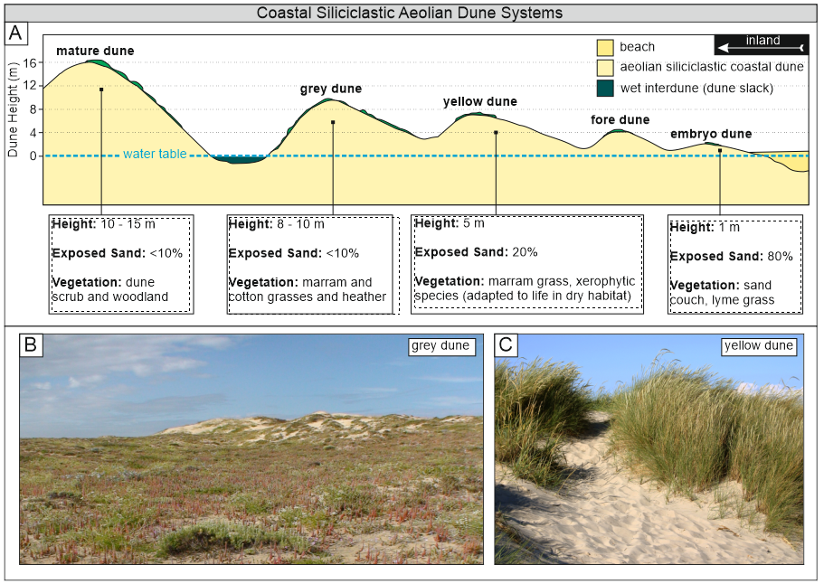
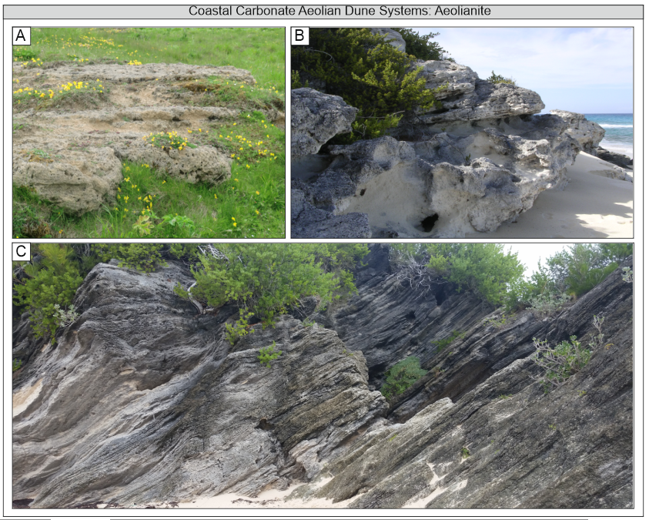
Coastal aeolian environments
A) Changes in coastal siliciclastic sand dunes with distance inland. Modified after www.internetgeography.net. B) A Grey dune in Baleal, Peniche, Portugal. Image courtesy of Júlio Reis (CC BY-SA 3.0). C) A yellow dune with Marram Grass in Grenen, Denmark. Image courtesy of Malene Thyssen (CC BY-SA 3.0)
A) Aeolianite, Aikerness on the island of Orkney, Scotland. Image courtesy of W. L. Tarbert (CC BY-SA 3.0). B) Holocene aeolianite, Long Island, Bahamas. Image courtesy of Mark A. Wilson. C) Aeolianite, Horseshoe Bay, Bermuda. Image courtesy of Pi3.124 (CC BY-SA 4.0).

Slide 19
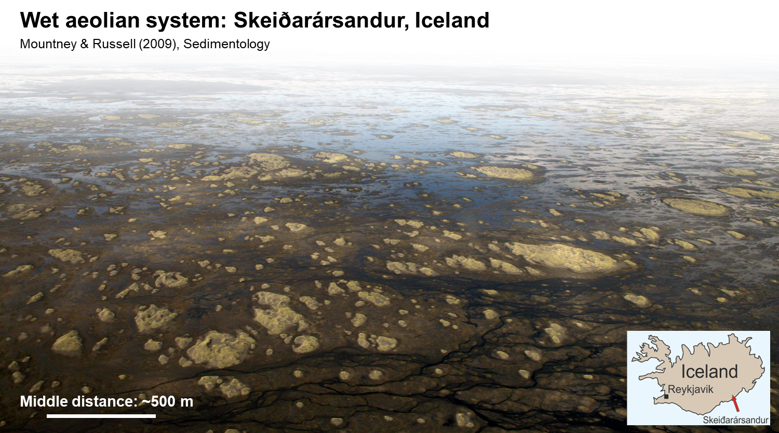
Non-desert aeolian environments
Aeolian processes are also widespread in many humid settings where there exists a surfeit of sediment available for transport and the wind velocity is sufficiently great to overcome resistive forces induced by the presence of moisture on sediment surfaces.
Notable this includes pro-glacial regions (McKenna-Neuman & Gilbert, 1986).
In many humid settings, however, the presence of vegetation can have a stabilizing effect on depositional surfaces, thus inhibiting aeolian processes.
In the example here, high wind speeds enable significant aeolian sand transport, despite the overall humid climate setting and a generally high water-table level.

Slide 20
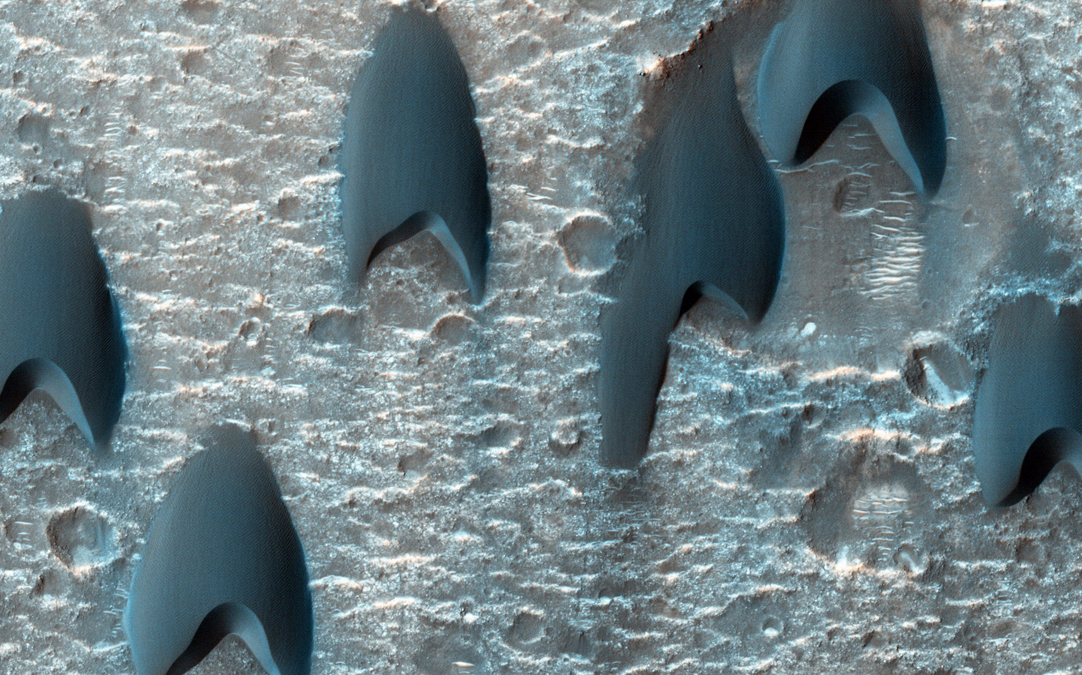
Extra-terrestrial aeolian environments
HiRise false colour image of barchan dunes on Mars
(Image: NASA-PIA17981)
Extra-terrestrial aeolian environments are not limited to planets alone. They exist on various celestial bodies, including Mars, Venus, Earth's Moon, Titan (Saturn's moon), and asteroids like Eros and Itokawa.
Active aeolian bedforms of the Bagnold dune field (35 km long, by 2 km wide) in the Gale crater have been investigated in detail by the NASA Curiosity Rover.

Slide 21
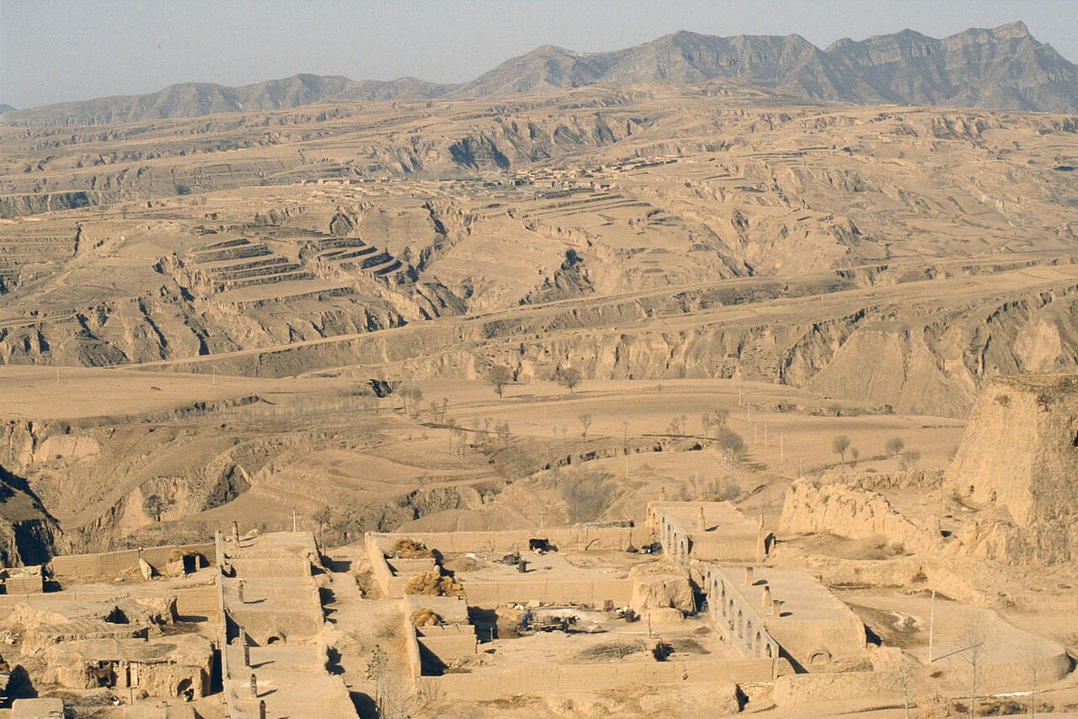
Aeolian loess environments
Loess is composed of fine, wind-blown silt and clay particles
Loess deposits are found in various regions around the world, but they are most commonly associated with areas that have experienced extensive glacial activity during past ice ages.
Prominent loess regions include the American Midwest, the Loess Plateau in China, the Russian steppes, and parts of Europe.
Loess formation typically occurs in areas where strong winds carry fine-grained sediment from exposed surfaces, such as glacial outwash plains, river valleys, and deserts.
Loess is known for its high fertility due to its mineral-rich composition and ability to retain moisture. Despite its fertility, loess can be vulnerable to erosion, especially when exposed by agricultural practices or construction activities.
Chinese Loess Plateau
Image by I, Till Niermann, CC BY-SA 3.0, https://commons.wikimedia.org/w/index.php?curid=2299288

Slide 22
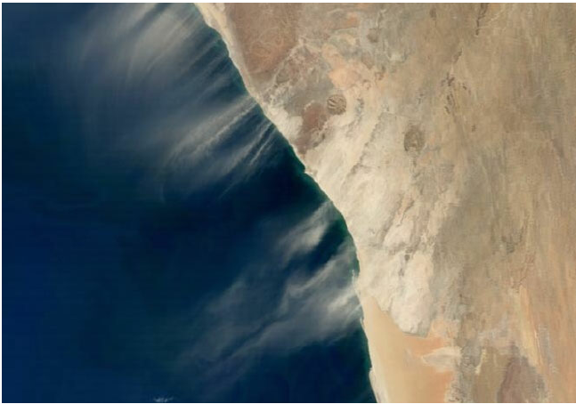
Aeolian contributions to other systems
Aeolian transport of dust occurs where strong winds lift and carry large amounts of dust in the atmosphere, typically in arid or semi-arid regions with loose, dry soil or sandy terrain.
Dust can reach atmospheric concentrations in excess of 6000 μg m−3 in severe events (Song et al ., 2007).
Dust storms can have significant societal impacts, including reduced visibility and transportation disruptions, reduced productivity in agricultural regions, and dust-related respiratory diseases.
Sand and dust storms play an important role in ocean fertilization (Han et al., 2008), carrying significant amounts of nutrient-rich dust particles into the ocean, which can stimulate the growth of phytoplankton – the primary producers in the oceanic food chain. This process is known as ocean fertilization.
Dust storm from the Namib Desert. Image from Pfiz et al. (2010)

Slide 23
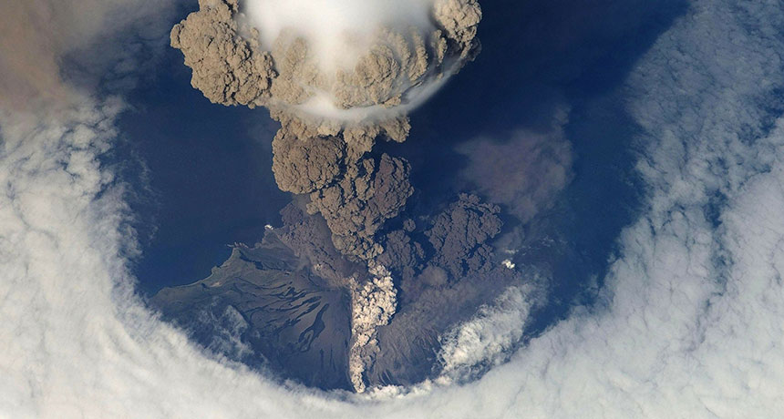
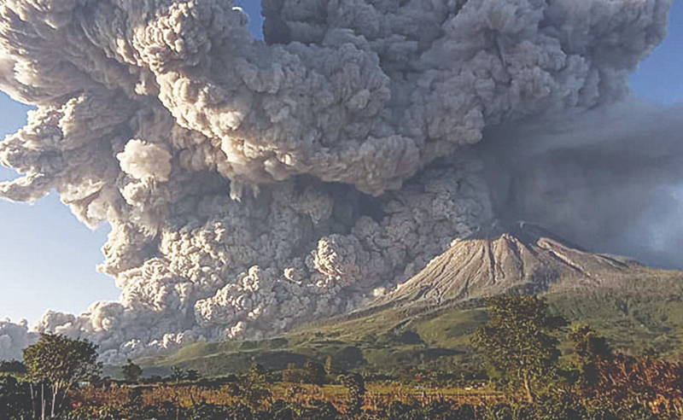
Aeolian contributions to other systems
Aeolian transport of volcanic ash can occur over 100s – 1000s km, depending on eruption magnitude, wind patterns, and atmospheric conditions.
Fine ash particles (<0.1 mm) can remain airborne for extended periods and be transported over vast distances, while coarser particles tend to settle closer to the source of eruption.
Particle density and shape influence the settling velocity and suspension characteristics of volcanic ash.
Lighter, more irregularly shaped particles have greater potential for prolonged suspension and long-distance transport.
Ash plumes can spread across entire regions or even continents, affecting air quality, visibility, and human activities.
WIKIIMAGES/PIXABAY.COM
https://kuwaittimes.com/indonesian-volcano-erupts-again-spewing-ash-cloud/

Slide 24
Aeolian Systems: Processes and Deposits
What are aeolian transport processes and where do they operate?
How do aeolian bedforms develop?
How do migrating bedforms in active dune fields form sediment accumulations?

Slide 25
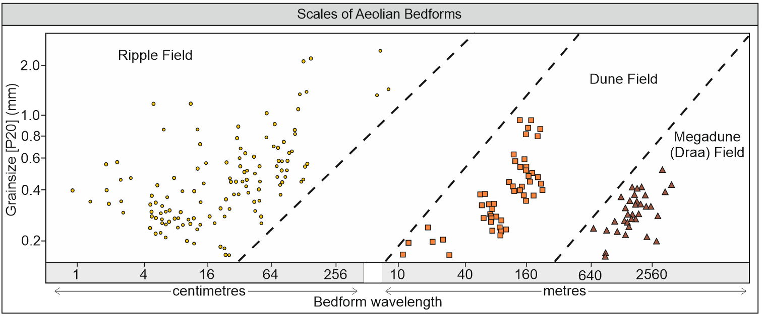
Aeolian Bedforms
Three distinct scales of aeolian bedform that commonly occur on Earth: ripples, dunes and megadunes (draa). A) Grainsize (coarsest twenty-percentile) versus wavelength for aeolian bedforms. Modified after Wilson (1972). Note that bedforms developed at scales between the three fields depicted in the graph do occur on Earth, but are less common.

Slide 26
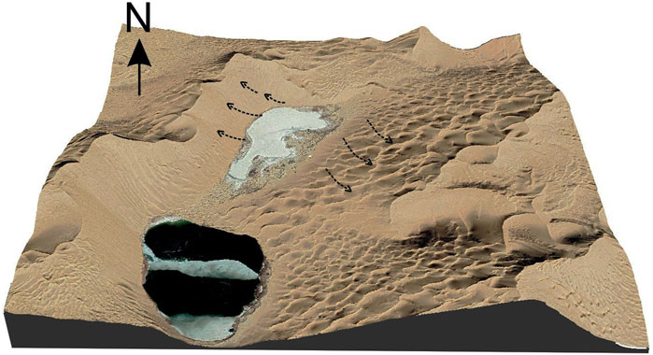
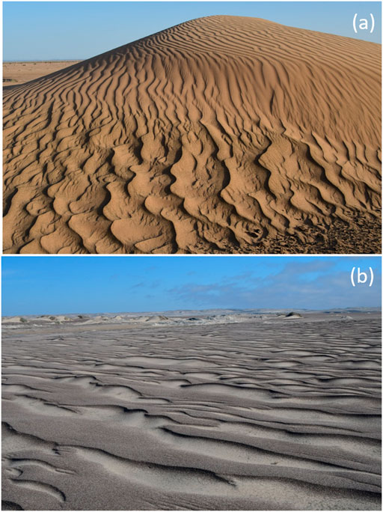
Aeolian Bedforms
Aeolian ripples, dunes and megadunes (draa) form a hierarchy of equilibrium bedforms and one or more of these types are present in the great majority of depositional aeolian environments
Bedform size provides a basis for initial bedform classification and description.
Almost all dunes and megadunes have ripples present on many parts of their sloping surfaces, and ripples are also common on sandsheet surfaces and in interdunes.
Three morphologically distinct types of small-scale ripple structure occur on wind-blown surfaces: impact ripples, megaripples, adhesion ripples.
Each are also recognised in vertical section, where they produce different types of aeolian ripple lamination or stratification.
Badain Jaran Sand Sea; from Dong et al. (2022)
Dune in Morocco near Merzouga; from Yizhaq et al. (2021)

Slide 27
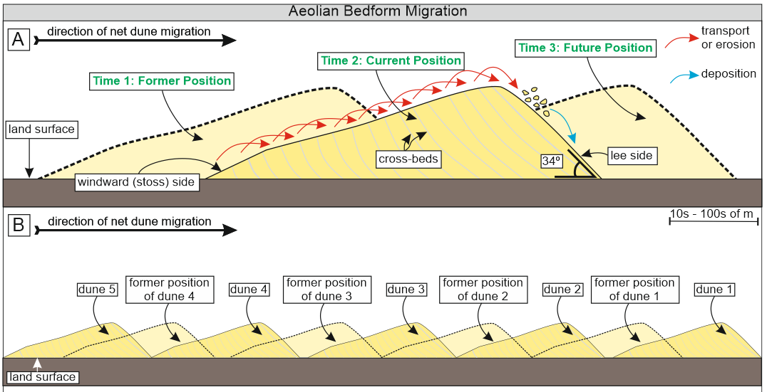
Aeolian bedform Migration
Image: Mountney et al., 2023
Ripples, dunes and megadunes (draas) that are migrating under the influence of the airflow comprise the sediment that is in transport. Although such bedforms may be large and slow moving, over longer time scales (months, years, or longer) they can move significant distances.
Ripples, dunes and megadunes commonly develop into a train of regularly spaced and repeated bedforms that records the response of a sand bed to the shearing action of the wind. A train of bedforms records a stage towards dynamic equilibrium in response to a varying but consistent fluctuation in the flow pattern (e.g., Jimenez et al., 1999).

Slide 28
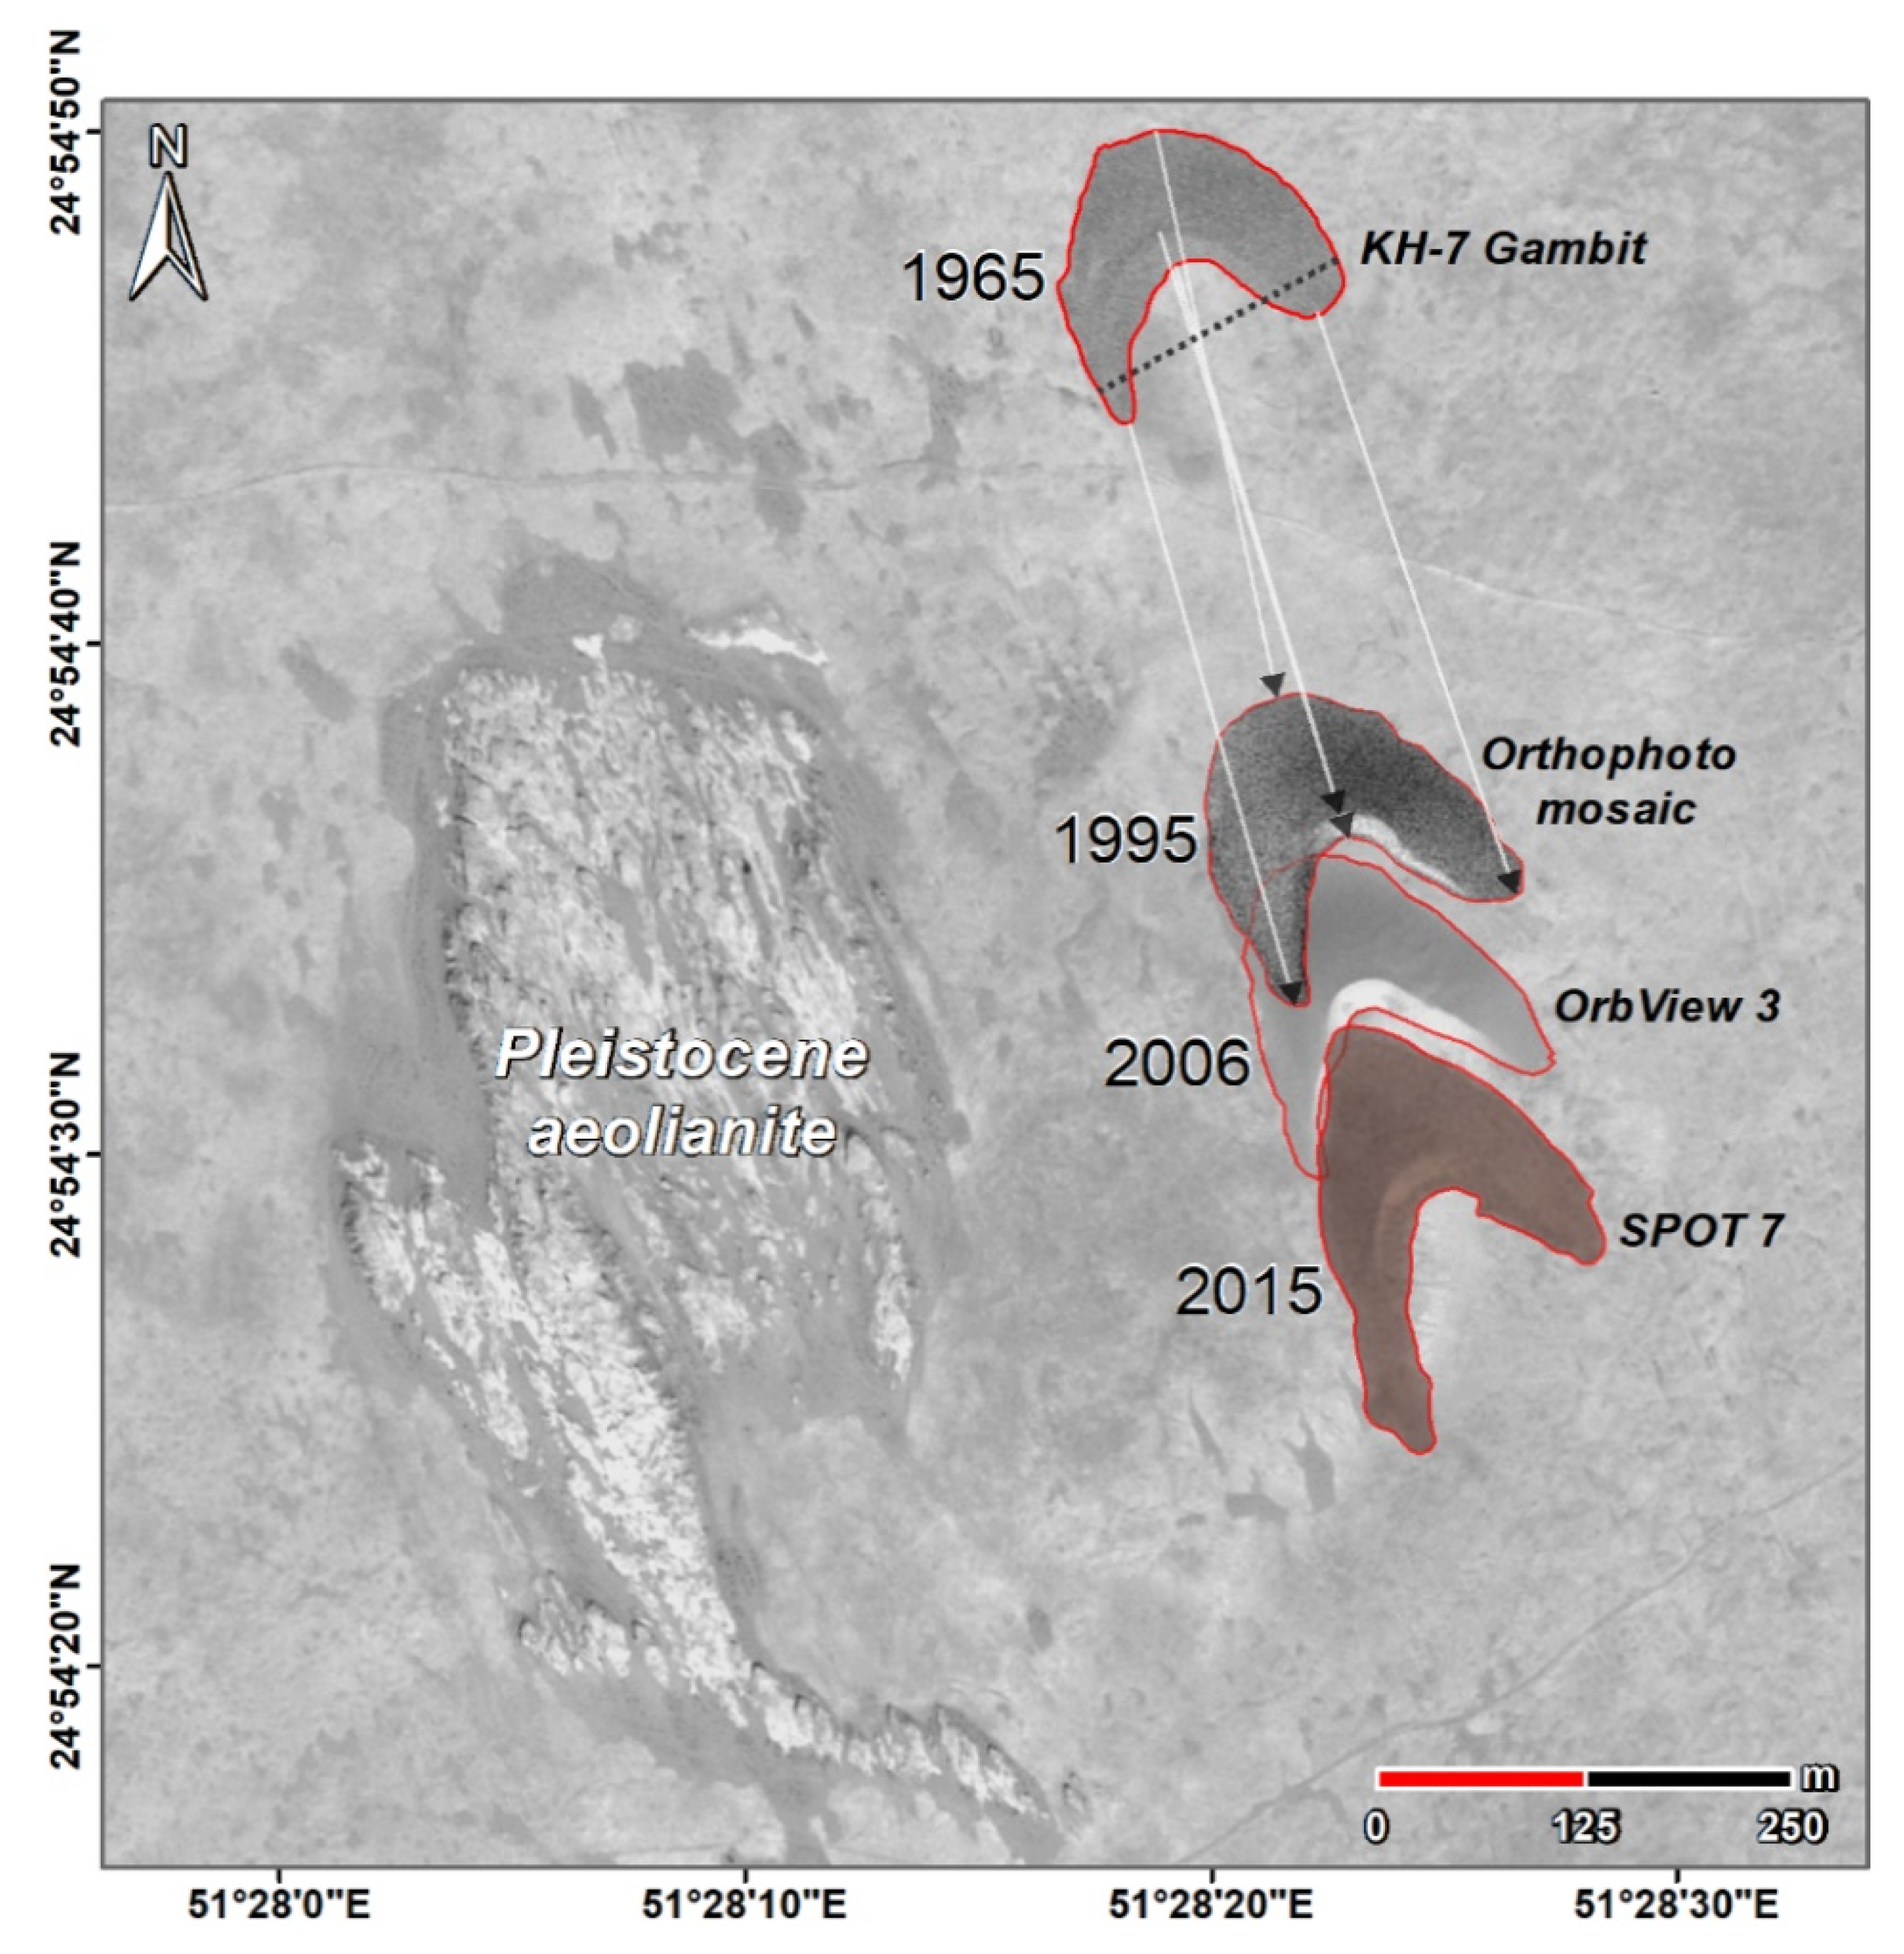
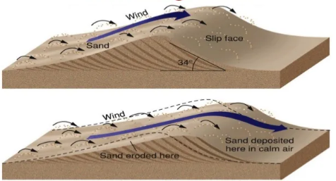
Aeolian bedform Migration
Migration of barchan dunes in Qatar (from Engel et al., 2018)
From: https://www.pamhage.com/post/2016/11/22/building-your-world-dunes

Slide 29
Aeolian Bedforms
Three distinct scales of aeolian bedform that commonly occur on Earth: ripples, dunes and megadunes (draa). A) Grainsize (coarsest twenty-percentile) versus wavelength for aeolian bedforms. Modified after Wilson (1972). Note that bedforms developed at scales between the three fields depicted in the graph do occur on Earth, but are less common.

Slide 30
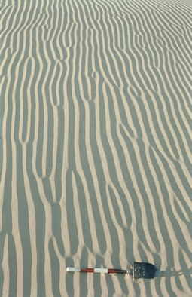
Aeolian wind-ripple strata
Wind ripples are the most widespread ripple type developed in aeolian environments (Hunter, 1977a, b; 1981).
They have low relief, and form preferentially from the coarser-grained fraction of the sand in transport.
They typically have wavelengths of 50 to 200 mm and heights of 5 to 10 mm, rarely up to 30 mm.
They exhibit a high ripple-form index (ratio of wavelength to height), typically between 12 and 50.
They may have straight or curved (in some cases sinuous), continuous crestlines, usually oriented transverse to the local wind direction.
Wind ripples are slightly asymmetrical in profile, though with their lee faces inclined at relatively low gradients (<20°), below the angle of repose for loose dry sand.
Impact ripples develop through a combination of saltation and reptation.
Left: Wind ripples on crescent-shaped sand dunes (Barchans) in Southwest Afghanistan (Sistan).
Image courtesy of Kempf EK

Slide 31
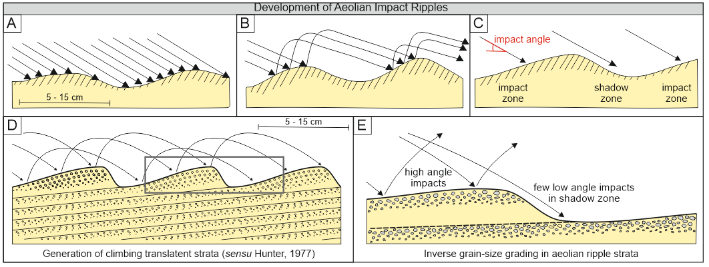
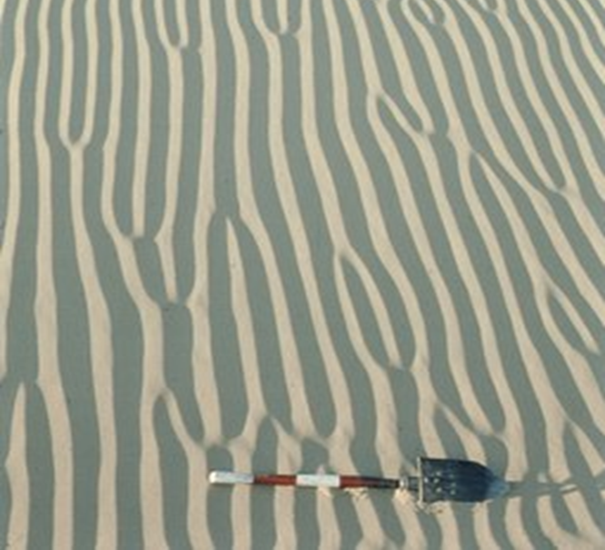
Aeolian wind ripple strata
Image: Mountney et al., 2023
Perturbations on a bed expressed as surface roughness influence how grains landing from saltation arrange themselves on the bed. This initiates the onset of ripple development.
Impact ripple spacing is determined by the saltation path length, which is a function of grain size, shape and density, and mean wind velocity and gustiness close to the bed.
Aeolian impact ripples have upwind-facing stoss slopes subject to impact of incoming grains and downwind-facing lee slopes where shadow zones develop. Modified after Anderson (1987).
Left: Wind ripples on crescent-shaped sand dunes (Barchans) in Southwest Afghanistan (Sistan).
Image courtesy of Kempf EK

Slide 32
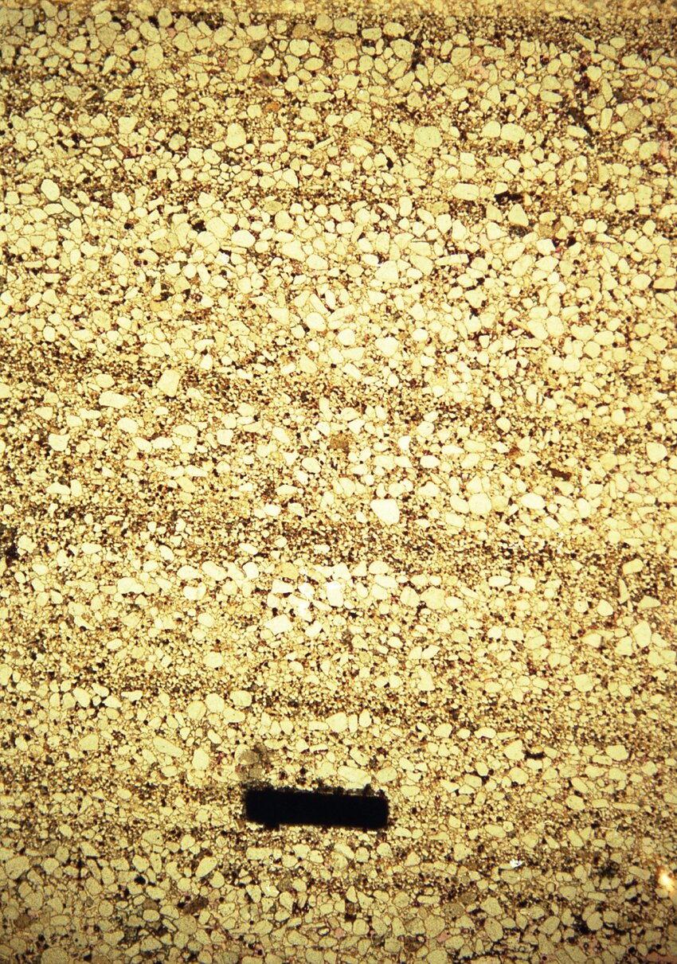
Aeolian wind ripple strata
Image: Mountney et al., 2023
D) Wind ripples generated by ballistic impact of incoming (i.e. landing) saltating grains. The ripple spacing relates in a general way to the saltation path length
E) The impact angle of saltating sand grains differs between stoss and lee slopes. High-angle impacts on the stoss slope of the impact ripples promotes creep of coarser grains towards the ripple crest. Downwind-facing lee slopes form a shadow zone where relatively few low angle impacts occur, thereby allowing the accumulation of finer grains in ripple troughs. As ripples migrate downwind this sorting mechanism generates lamination with inverse grading.
Climbing wind-ripple strata in Navajo Sandstone. From Samson (1992)

Slide 33
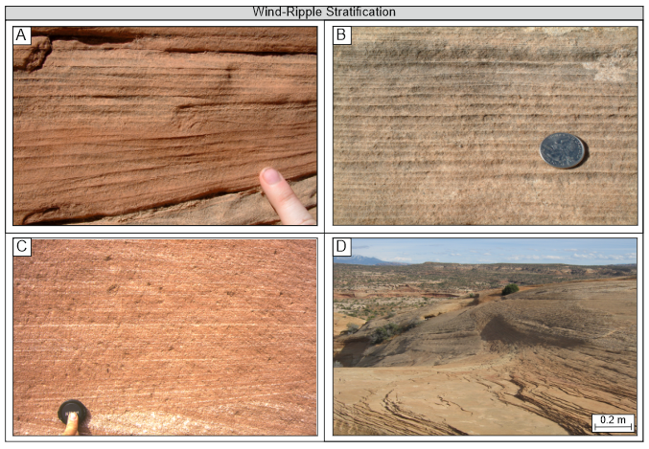
Aeolian wind ripple strata
Aeolian truncated ripple-foreset cross-laminae. Jurassic Navajo Sandstone, Utah, USA.
Subcritically climbing translatent strata for which no ripple-foreset cross-laminae are evident. Permian Cedar Mesa Sandstone, Utah, USA.
Pinstripe lamination representing the accumulated deposits of aeolian ripples that climbed over one another at very low subcritical angles. Each stripe records the passage and accumulation of one ripple in a train, whereby slightly finer-grained fractions represent the passage of the ripple troughs and slightly coarser-grained fractions represent the passage of the ripple crests. Twyfelfontein Formation (formerly Etjo Sandstone), Namibia.
Packages of wind-ripple strata on the low-angle-inclined lower flanks of a cross-bedded aeolian dune set. Jurassic Navajo Sandstone, Utah, USA.
Image: Mountney et al., 2023

Slide 34
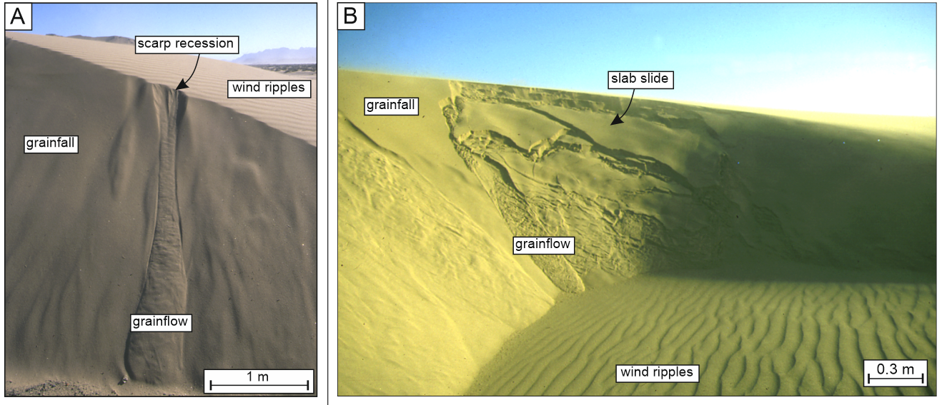
Associated aeolian facies: grainflow strata
Image: Mountney et al., 2023
From: https://www.pamhage.com/post/2016/11/22/building-your-world-dunes
The gravitational collapse of dry, loose sand on aeolian dune and megadune lee slopes inclined at the angle of repose (typically 32-36°) generates grainflow sand avalanches. Grainflows gather momentum as they pass down the lee slope and may run out onto lower-angle-inclined bedform plinths and flanks. Grainflow avalanches generate sediment units that are inclined at 18-36° within cross-bedded foreset deposits (the inclination is reduced by sediment compaction in ancient strata).

Slide 35
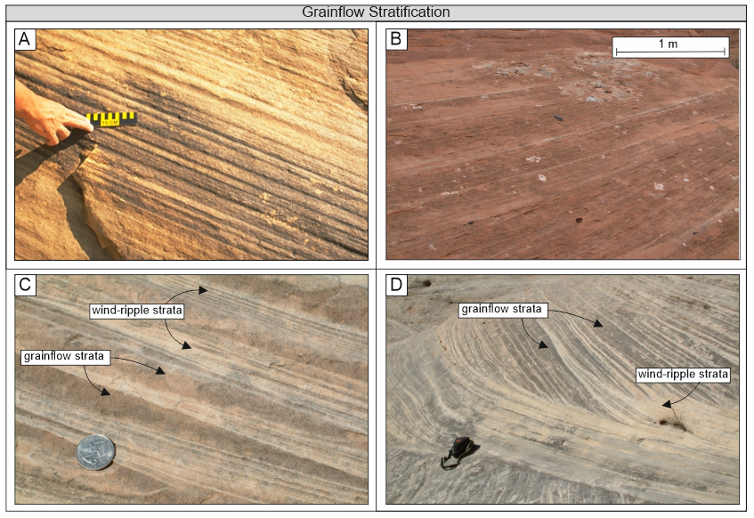
Associated aeolian facies: grainflow strata
Aeolian grainflow stratification.
A) Thick package of multiple stacked aeolian grainflow avalanche deposits, Twyfelfontein Formation (formerly Etjo Sandstone), Namibia.
B) Grainflow strata with many indivdual stratum delineated by thin grainfall laminae. Jurassic Entrada Sandstone, Utah, USA.
C) Internally structureless grainflow deposits intercalated with wind-ripple translatent strata.
D) Wider view of the same intercalated package of grainflow and wind-ripple strata revealing their arrangement in the lower part of a cross-bedded aeolian dune set. C and D: Permian Cedar Mesa Sandstone, Utah, USA.
Image: Mountney et al., 2023

Slide 36
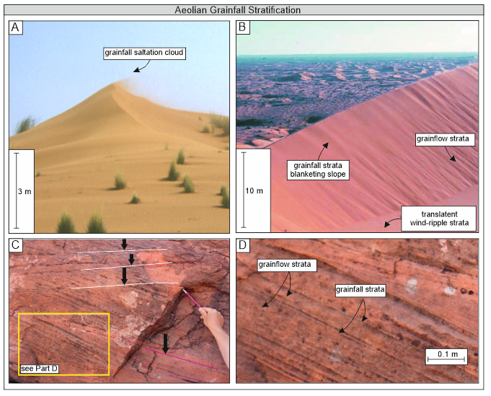
Associated aeolian facies: grainfall strata
Gravity-driven grainfall occurs commonly where the wind carries clouds of saltating grains over a dune brink. The airflow decelerates as it passes into the lee-side depression resulting in a reduction in sediment carrying capacity. Modern dune, Namib Desert, Namibia.
Grainfall may additionally occur on the flanks or apron of a dune where secondary cross-wind airflow is insufficient to form ripples. Arm of a star draa, northwest Gran Desierto, Mexico. Modified after Brookfield & Silvestro (2010).
Ancient example of grainfall stratification extending uninterrupted down to the base of the lee slope and blanketing grainflow stratification. Jurassic Page Sandstone, Arizona, USA. The white lines indicate set-bounding surfaces. The pink line indicates a reactivation surface, which records a period of lee-face erosion bounded by packages representing lee-face deposition.
Detail of individual units of grainflow stratification, each separated by thin, tabular units of grainfall stratification. Modified after Cardenas et al. (2019).
Image: Mountney et al., 2023

Slide 37
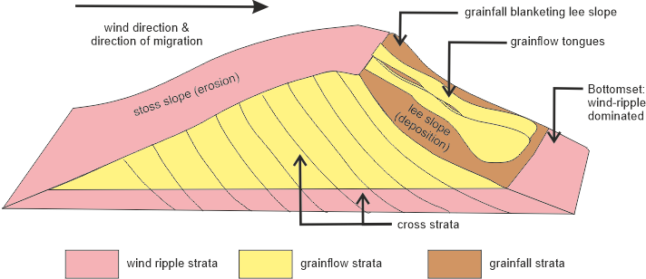
Aeolian Dune Facies

Slide 38
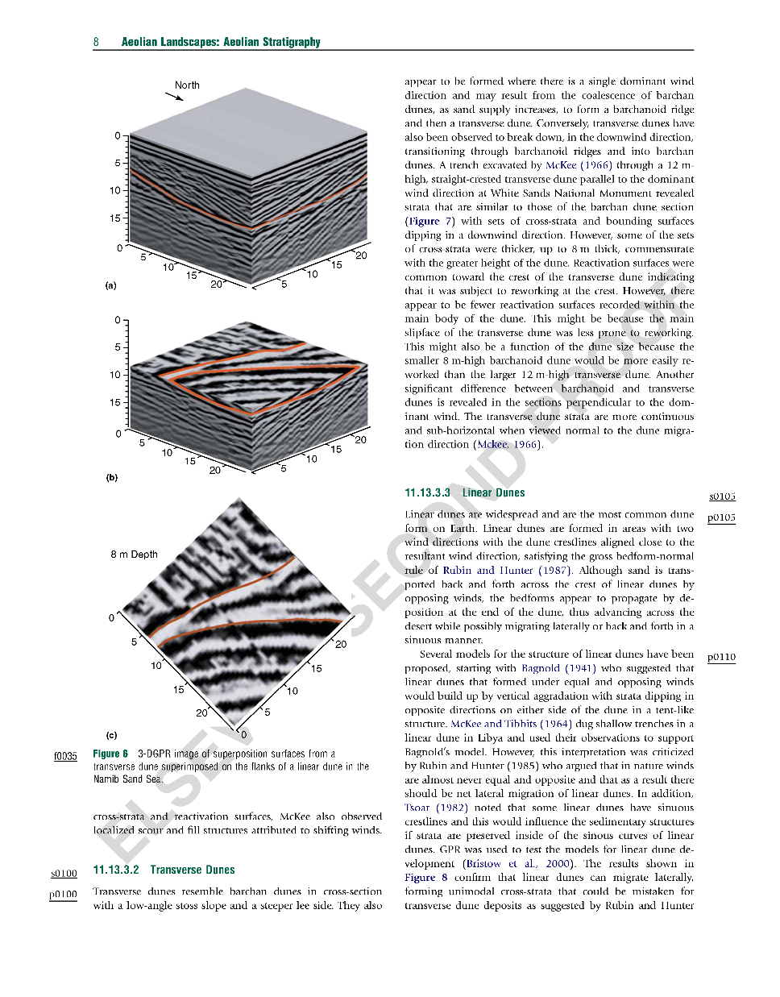
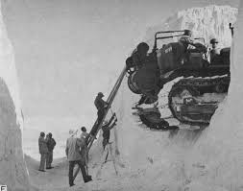
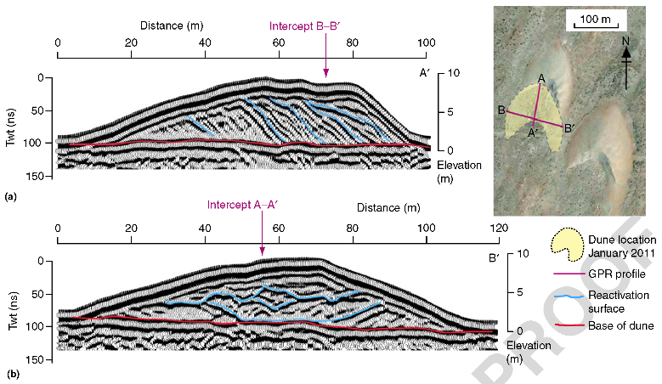
Aeolian Dune Facies
Right. 3D GPR data imaging superimposition surfaces arising form the migration of transverse dunes along the flanks for a larger megadune, Namib Sand Sea.
m
m
m
Below. 2D GPR profiles, barchan dune, Morocco
McKee (1966)
m
Above. The old days… trenching through dune sands with weak gypsum cement using unusual sedimentological field equipment, White Sands, New Mexico.
m
m
Bristow & Mountney (2012)

Slide 39
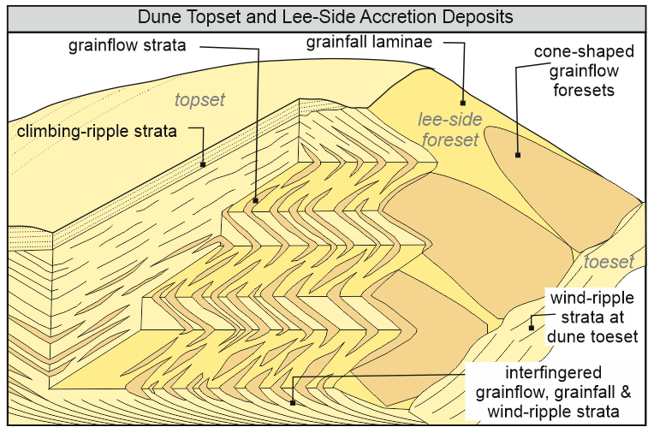
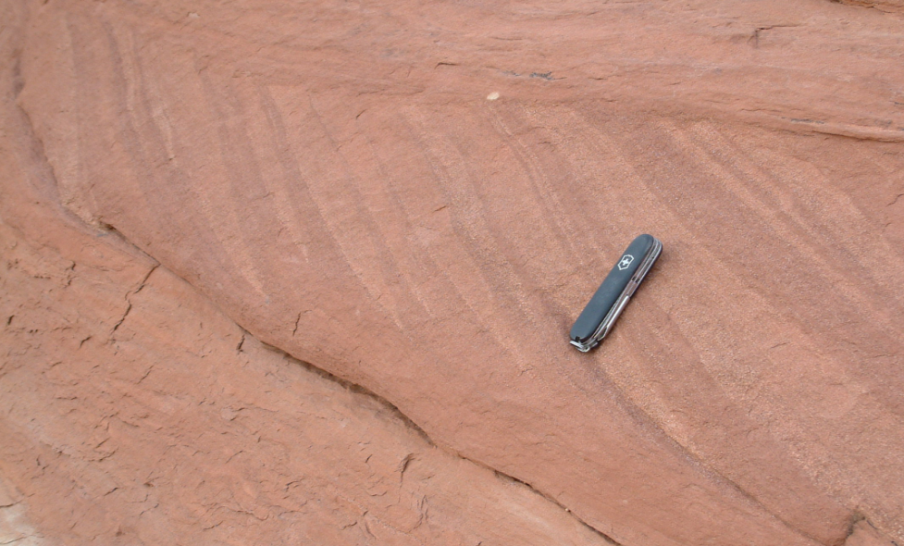
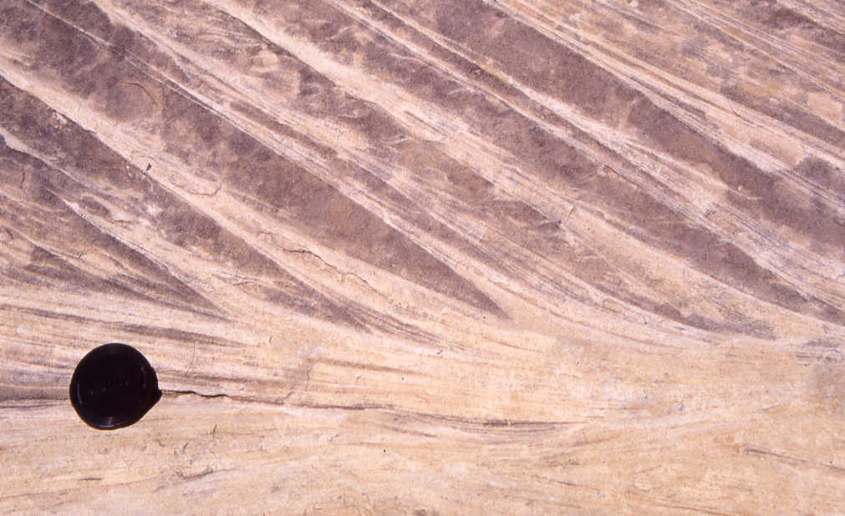
Aeolian Dune Facies
Images: Mountney et al., 2023
Top: Tongues of mixed grainflow and grainfall strata interbedded with and pinching out into wind-ripple strata at the toe of a cross-stratified dune set. Permian lower Cutler beds, Utah, USA. Bottom: Sharply defined tongues of grainflow strata interbedded with and pinching out into wind-ripple strata at the toe of a cross-stratified dune set. Permian Cedar Mesa Sandstone, Utah, USA.
Cross-stratification arising from aeolian dune migration and accumulation. Schematic block diagram showing the different small-scale structures of foresets of different type: simple cone-shape grainflow strata, grainfall strata and climbing-ripple strata.

Slide 40
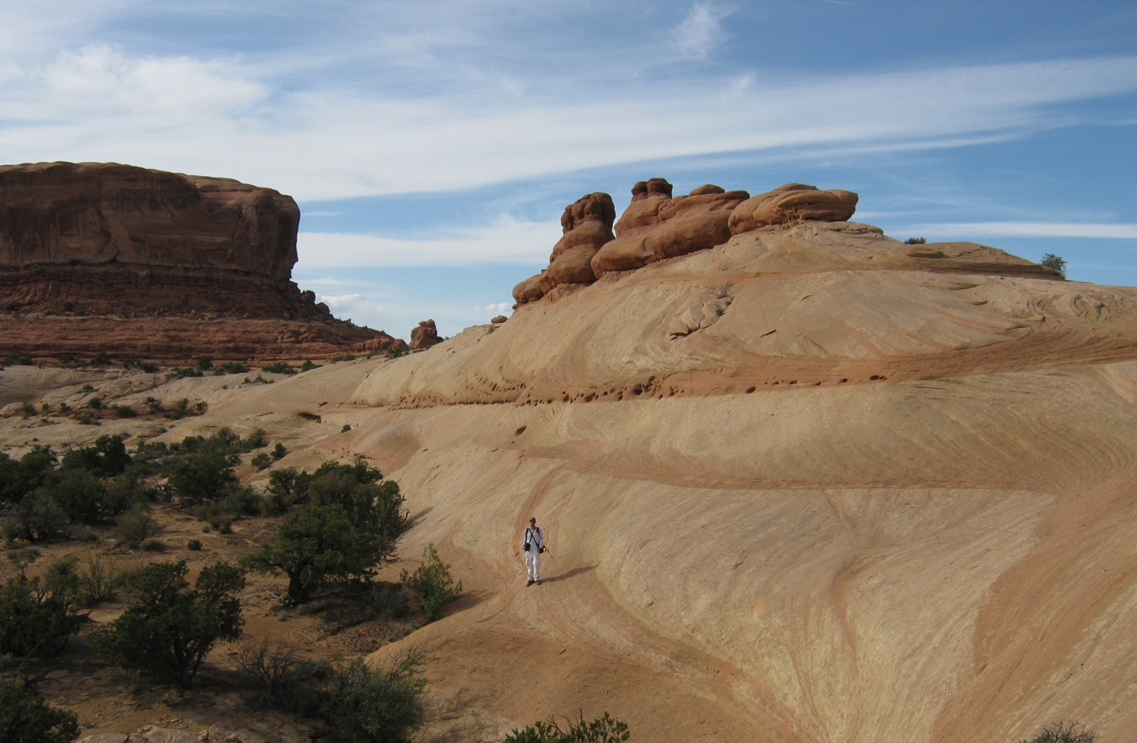
Bedform climbing in a dry aeolian succession
Aeolian Dune Facies
Palaeo-bedform migration direction
Low-angle-inclined bounding surfaces
Climbing cross-bedded sets
Large scale cross-bedding;
Jurassic Navajo Sandstone, Utah

Slide 41
Aeolian Bedforms
Three distinct scales of aeolian bedform that commonly occur on Earth: ripples, dunes and megadunes (draa). A) Grainsize (coarsest twenty-percentile) versus wavelength for aeolian bedforms. Modified after Wilson (1972). Note that bedforms developed at scales between the three fields depicted in the graph do occur on Earth, but are less common.

Slide 42
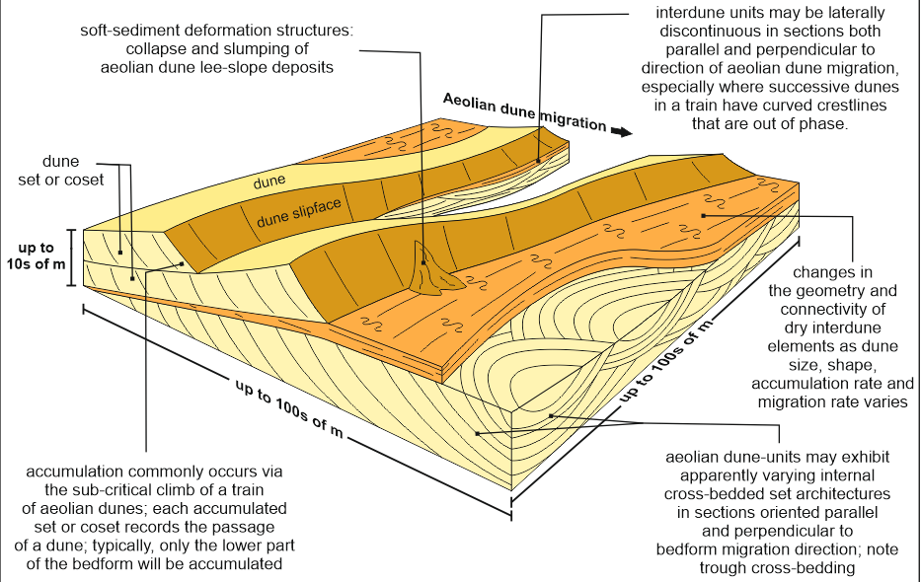
Aeolian bedforms: dunes
Modified after Cain (2009)
In situations where the net aeolian sediment budget is positive, accumulation occurs such that bedforms may climb over one another at various angles, thereby accumulating sets and cosets of cross strata, and associated bounding surfaces (Brookfield, 1977; Rubin & Hunter, 1982; Rubin, 1987a).
These sets and cosets are themselves internally composed of smaller-scale facies units of wind-ripple, grainflow, grainfall and plane-bedded strata, the relative proportions and distributions of which are determined by how processes operated upon the formative bedforms.
Thus, dune elements are larger-scale stratal units composed of a variety of arrangements of smaller scale bodies.

Slide 43
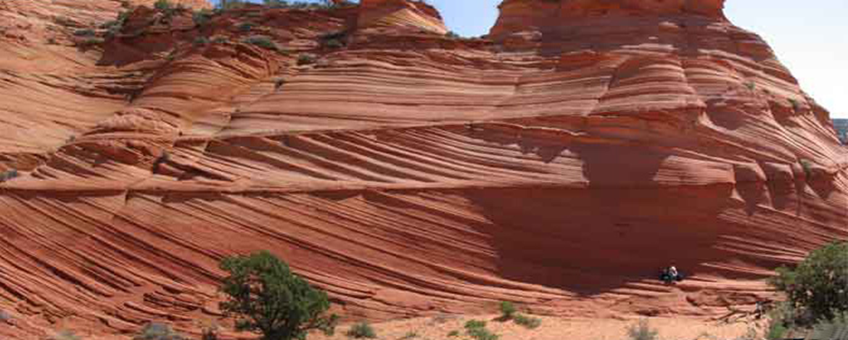
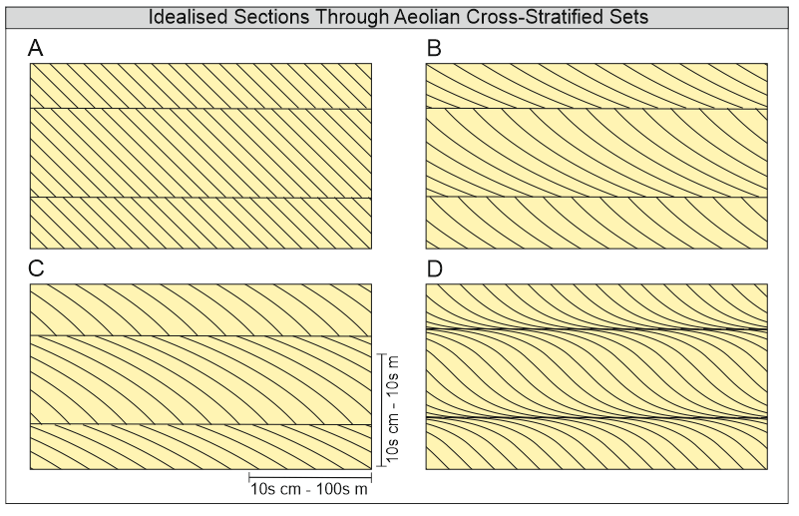
Aeolian bedforms: dunes
Where bedforms migrate over one another, typically as part of a bedform train, they commonly climb at low angles such that the lowermost cross-bedded deposits of one bedform are accumulated as a second bedform overrides them.
Cross strata generated by the first bedform are partly truncated by the passage of the second. The level of truncation (cut-off) generates a set of cross-strata bounded at its top by an erosional surface, a so-called bounding surface (Brookfield, 1977; Rubin & Hunter, 1982; discussed later).
Photo shows cross-bedded dune-sets in the Navajo Sandstone, Utah, USA. Image courtesy of Jim Elder.
Image: Mountney et al., 2023
Idealised sections in tabular cross-stratified aeolian dune sets oriented parallel to flow. A) Planar foresets with angular bases. Common. May be generated by the migration of small transverse aeolian dunes. B) Curved foresets with asymptotic of tangential bases. Very common. May be generated by the migration of small or large aeolian dunes of various type. This type is a useful way-up indicator.

Slide 44
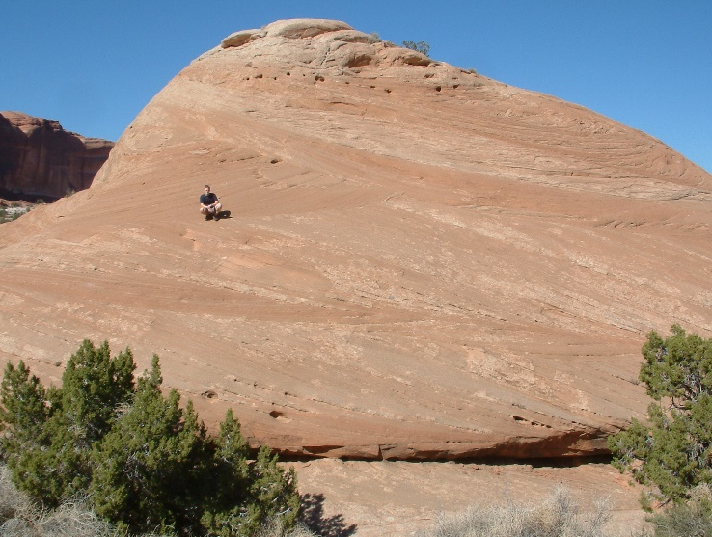

Aeolian bedforms: interdunes
Mountney & Russell (2004)
Aeolian interdunes are elongated, relatively flat, and sandy landforms that exist between larger sand dunes in desert and arid environments. They typically form in the low-lying areas between dune crests.
Dry interdune: water table is not in contact with the depositional surface
Damp interdune: capillary fringes of the water table are in contact with depositional surface
Wet interdune: water table is in contact with the depositional surface
6 m
Dry aeolian system: Navajo Sandstone, SE Utah (Jurassic)
Wet aeolian system: Askja, NE Iceland (modern)
Dry interdunes associated with wind-ripple strata
Wet interdunes & damp interdunes are associated with subaqueous ripples and adhesion strata

Slide 45


Aeolian bedforms: interdunes
A) Summary model depicting the typical three-dimensional geometry and internal anatomy of damp and wet interdune architectural elements. Modified after Cain (2009). B) Example of horizontally bedded wet interdune architectural elements (red) between cross-bedded aeolian dune elements (off-white). Jurassic Navajo Sandstone, southeast Utah, USA.

Slide 46

Aeolian interdune facies: adhesion strata
Adhesion strata arise from the adhesion of moving grains to a damp surface, such as a damp interdune (Hummel and Kocurek, 1984).
Adhesion strata typically are low relief (several mm in height) and exhibit sub-horizontal structures with irregular surfaces.
Adhesion strata can be further subdivided into adhesion plane beds, adhesion ripples (Kocurek and Fielder, 1982) and adhesion warts (Olsen et al., 1989), where appropriate.
Examples of aeolian adhesion structures. Morphometry of
aeolian adhesion ripples,
aeolian adhesion warts
aeolian plane-beds, with summary explanations of processes of formation. Modified after Kocurek & Fielder (1982).
Adhesion warts generated on a surface of damp sand over which dry sand has been blown. Indian Creek, Utah, USA.
Adhesion warts. Independence Fjord Group, Proterozoic, North Greenland. Collinson & Mountney (2019).

Slide 47
Megadunes
Megabedforms or draas are very large (wavelengths of 500–5000 m and heights >50 m; Wilson, 1971, 1972) bedforms that are compound or complex in form (sensu McKee, 1979) where they support the development of superimposed dune-scale bed forms.
Compound draas occur where a smaller dune is superimposed on a larger dune of the same morphological type
Complex draas occus where a smaller dune is superimposed on a larger dune of a different morphological type
Badain Jaran Sand Sea; from Dong et al. (2022)

Slide 48

Aeolian sandsheets and zibars
ancient
Aeolian sandsheets are areas of sand accumulation that lack significant development of high-relief dune-scale or larger bedforms, but are instead characterised by relatively flat areas of impact wind ripples.
Sandsheet development is controlled by a variety of factors. Commonly there exists an overall positive net sediment budget but which is restricted by the limited supply and/or availability for transport of sand (Breed et al., 1987; Khalaf, 1989; Kocurek & Nielson, 1986).
Photo shows sandsheet deposits from the Upper Tulum Valley, central-western Argentina (Dal' Bó and Basilici, 2015)
In some cases, low-relief ridges and domes (zibars) with gently inclined sloping surfaces (dip < 10°; relief no more than a few metres) are present (Nielson & Kocurek, 1986).
Also known as proto-dunes
Tenéré Desert, larger Sahara Desert, Niger (Image ISS022-E-5258)
modern
5 km

Slide 49
Aeolian Systems: Processes and Deposits
What are aeolian transport processes and where do they operate?
How do aeolian bedforms develop?
How do migrating bedforms in active dune fields form sediment accumulations?

Slide 50

Dune Migration
Image: Mountney et al., 2023
The accumulation of aeolian sequences does not automatically ensure their long-term preservation. Indeed, evidence from the Quaternary record (e.g., Kocurek et al., 1991a; Kocurek, 1999) argues that entire ergs may be constructed and accumulated to considerable thicknesses, only to be later deflated to leave no record. Long-term preservation requires that the body of strata is placed below a regional baseline, beneath which erosion does not occur. Thus, the rate of generation of accommodation and the rate at which aeolian accumulations fill that space is a fundamental control on preserved architectural style (Havholm & Kocurek, 1993; Howell and Mountney, 1997; Mountney & Howell, 2000; Cosgrove et al., 2021c).

Slide 51

Dune Migration

Slide 52

Dune migration and preservation
The principal agent that generates accommodation and promotes preservation is subsidence.
Long-term preservation of an aeolian succession can be achieved in many ways, but two mechanisms are widely identified.
First, where an accumulation occurs within a subsiding basin in which accommodation is available to be filled, it can be placed beneath a so-called baseline of erosion – the level down to which deflation can proceed due to aerodynamic configuration (Kocurek & Havholm, 1993).
Second, where an accumulation is placed beneath the water table, thereby protecting the aeolian accumulation from later deflation. This can occur either via subsidence through a static water or, on shorter geological timescales, via an absolute rise in water-table level.
Image: Mountney et al., 2023

Slide 53


Summary
Photo shows cross-bedded dune-sets in the Navajo Sandstone, Utah, USA. Image courtesy of Jim Elder.
Aeolian processes operate in a variety of erosional and depositional settings, notably hot and cold climatic deserts, coastal regions, fluvial and glacial outwash plains, and volcanic regions, and even supply sediment to the deep ocean.
Although aeolian processes operate in various climate regimes, they are currently most active and widespread in arid, hot and cold deserts.
Aeolian deposits occur at a variety of scales, from smallest to largest these are ripple-, dune-, and mega-dune scale
At the smallest scale: wind-ripples, grainflow, grainfall and adhesion strata
Aeolian dunes are associated with interdunes (dry, damp, wet), sandsheets and zibars
Aeolian dunes and interdunes accumulate by climbing over one another.
Overlying bedforms truncate underlying bedforms leaving cross-bedded sets in geological record
Image: Mountney et al., 2023

